Slide 1
Aakash Goel https://www.linkedin.com/in/goelaakash123/
Session 4:
Edge Detection and Line Detection
Acknowledgement: Slide Materials adopted from - Intro to Computer Vision (Cornell Tech); Noah Snavely, prepared by the lead instructor Prof S P Vimal , modified (added some content) by Aakash Goel

Slide 2
Topics
Edge Models & Approaches to edge detection
Hough Transform - Detecting Lines
Acknowledgement: Slide Materials adopted from - Intro to Computer Vision (Cornell Tech); Noah Snavely

Slide 3
What is an Edge ?
Analogy: Imagine a sharp boundary between two colored walls—one red and one white. That sharp change in color is like an "edge" in an image.
Definition: An edge is a region in an image where intensity changes sharply. It's the boundary between objects, textures, or colors.

Slide 4
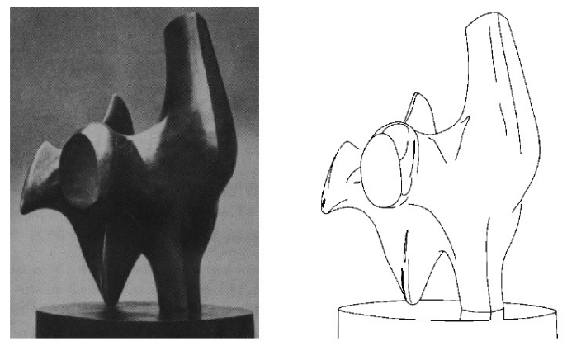
Edge Detection
Task : Convert a 2D image into a set of curves (made of edges)

Slide 5
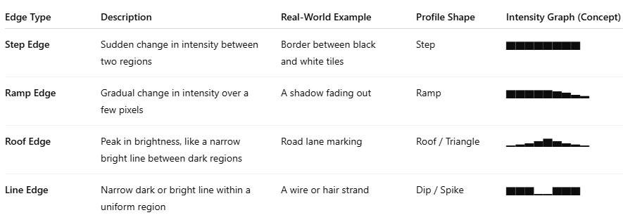
Edge Profiles
An Edge Profile describes how the pixel intensity changes across an edge in an image.
Think of it like a graph of brightness as you move across a line in the image. This helps us understand how sharp or gradual an edge is.

Slide 6
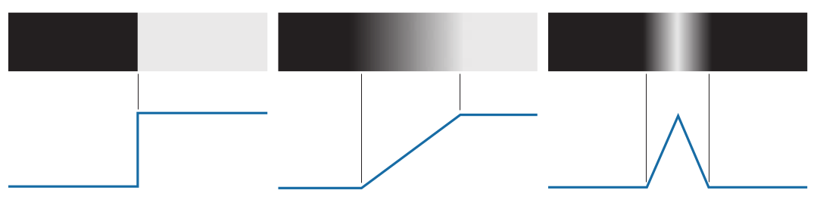
Edge Profiles
Step Edge Ramp Edge Roof Edge

Slide 7
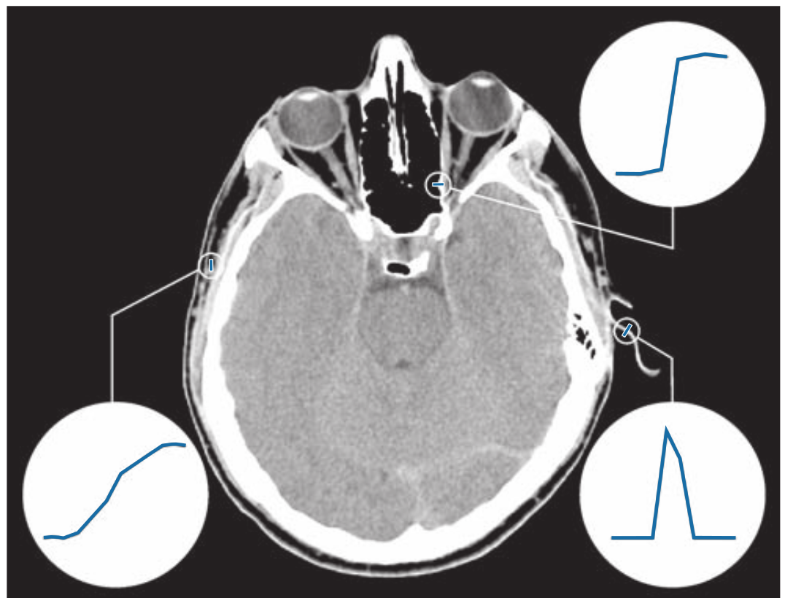
Example
CV 4: Edge and Line Detection
A 1508 1970 × image showing (zoomed) actual ramp (bottom, left), step (top, right), and roof edge profiles. The profiles are from dark to light, in the areas enclosed by the small circles. The ramp and step profiles span 9 pixels and 2 pixels, respectively. The base of the roof edge is 3 pixels. (Original image courtesy of Dr. David R. Pickens, Vanderbilt University.)

Slide 8
Edge Detection Approach
Category | Description
Gradient-based | Detect edges by checking sharp intensity change
Laplacian-based | Uses second derivative for sharper detection
Model-based | Fit lines or curves through edge data

Slide 9
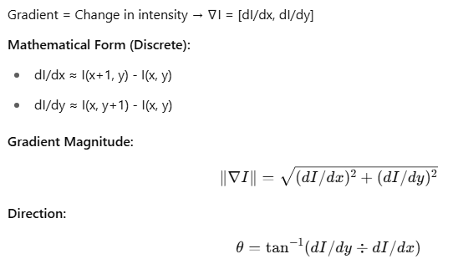
What is Gradient in Image processing ?
A gradient in an image tells us how much the intensity (brightness) is changing and in which direction it is changing.
If you think of an image as a landscape, the gradient shows how steep the hill is at any point and which way is uphill.

Slide 10
Example (1D) - Gradient
Imagine a Row of Pixels (1D)
[50, 52, 55, 60, 90, 130, 132, 133]
We can see a rapid change in values from 60 → 90 → 130. That’s where an edge exists.
Mathematically, we calculate the gradient by subtracting neighbor values:
Gradient ≈ Right – Left
Example:
At pixel 3 (value = 60):
Gradient ≈ 90 - 55 = 35 → High gradient → Edge
At pixel 1 (value = 52):
Gradient ≈ 55 - 50 = 5 → Low gradient → No edge

Slide 11
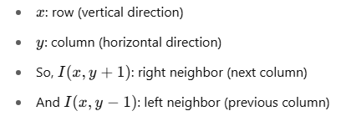
Example (2D) - Gradient
In 2D Images: Gradient in X and Y Directions
Each pixel has 2 neighbors in X-direction (left-right) and 2 in Y-direction (top-bottom).
Gradient in X:
Gx = I(x, y+1) - I(x, y-1)
Gradient in Y:
Gy = I(x+1, y) - I(x-1, y)
Magnitude of gradient = √(Gx² + Gy²)
Direction = arctangent(Gy / Gx)
This tells us how strong the edge is, and in which direction it points.

Slide 12
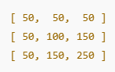
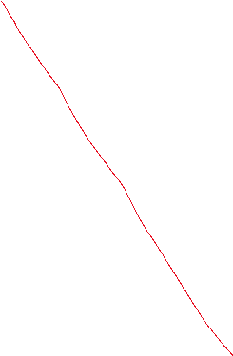

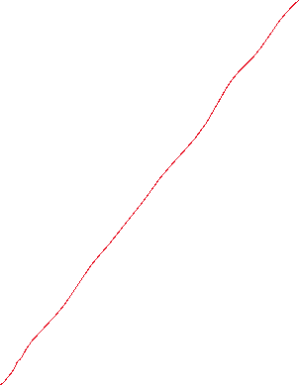

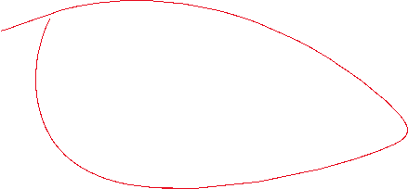


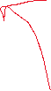
Example (2D) - Gradient
We want to compute the gradient at the center pixel (100).
Gx = Right - Left = 150 - 50 = 100
Gy = Bottom - Top = 150 - 50 = 100
Now:
Magnitude = √(100² + 100²) = √20000 ≈ 141
Direction = arctan(1) = 45°
This means there's a strong edge going diagonally from top-left to bottom-right.

Slide 13
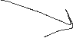
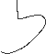




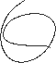





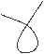

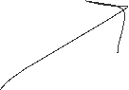
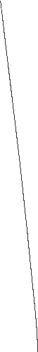




Slide 14
Using Sobel Operator (More Stable than Simple Difference)
The Sobel Operator is a better way to calculate gradients. It uses weighted differences:
It combines:
Differentiation (to detect edges)
Smoothing (to reduce noise)
https://pyimagesearch.com/2021/05/12/image-gradients-with-opencv-sobel-and-scharr/
📌 Why Sobel is Better:
Sobel uses all 9 pixels around the target pixel → more context.
Sobel applies weighted averaging (center row has more weight).
This helps it smooth out noise and detect sharper edges.

Slide 15
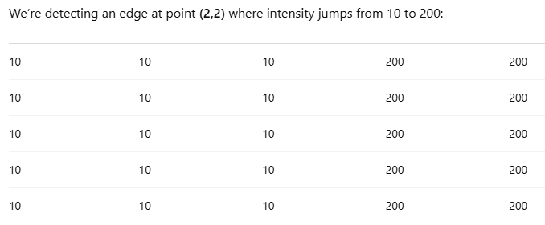
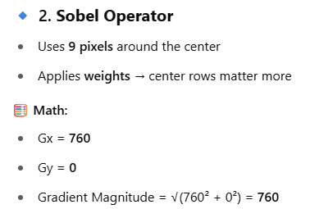
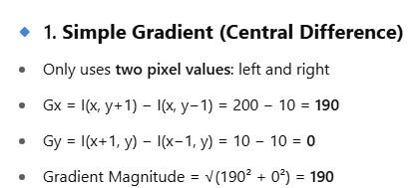



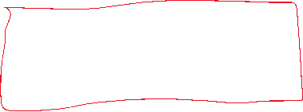

EXAMPLE – Naive Gradient Vs. Sobel
Imagine trying to detect a crack in a wall using just your left and right view (simple gradient) vs. using a 360-degree scan with depth sensors (Sobel). Which one gives a better idea of where the crack begins and ends?

Slide 16
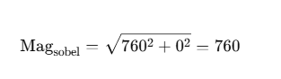
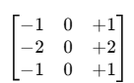




EXAMPLE – Naive Gradient Vs. Sobel
Gy_sobel = (-1*10 + -2*10 + -1*200) +
(0*10 + 0*10 + 0*200) +
(+1*10 + 2*10 + 1*200)
= (-10 -20 -200) + (0) + (10 + 20 + 200)
= (-230) + 0 + (230) = **0**
Top-left corner of the 3×3 window:
(1,1) to (3,3)
Values:
10 10 200
10 10 200
10 10 200
Gx_sobel = (-1*10 + 0*10 + 1*200) +
(-2*10 + 0*10 + 2*200) +
(-1*10 + 0*10 + 1*200)
= (-10 + 0 + 200) +
(-20 + 0 + 400) +
(-10 + 0 + 200)
= (190) + (380) + (190) = **760**

Slide 17
EXAMPLE – Naive Gradient Vs. Sobel
Sobel (760) | Simple Difference (190)
Uses multiple pixels | Uses only 2 pixels
Adds weight to neighbors | No context awareness
Emphasizes structure and direction | Only abrupt change
Better at finding real edges | Sensitive to noise

Slide 18
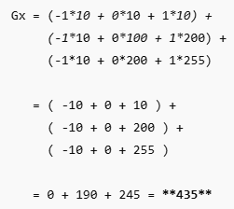
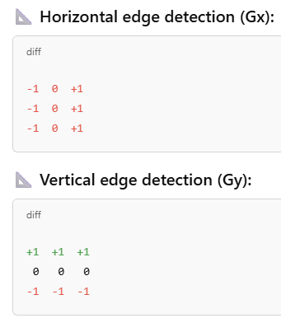
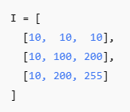
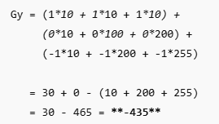
Prewitt kernels
The Prewitt operator is used to estimate the gradient of the image intensity function. It detects edges by looking at changes in brightness in horizontal and vertical directions.

Slide 19
Kirsch Compass Kernels
Kirsch Compass Operators are a set of eight 3×3 convolution masks used for detecting edges in all compass directions: North, Northeast, East, Southeast, South, Southwest, West, and Northwest.
They analyze pixel intensity in a directional manner — just like a compass showing directions — and pick the direction with the strongest response (highest edge strength).

Slide 20
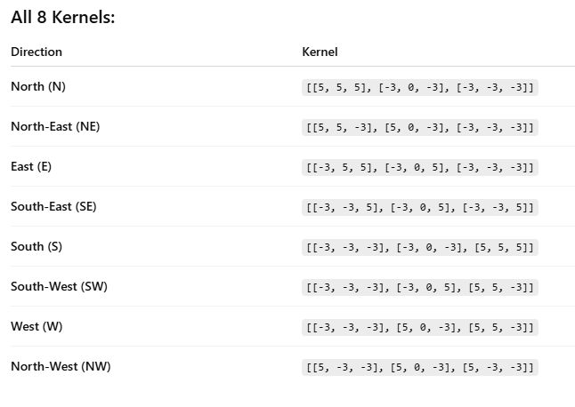
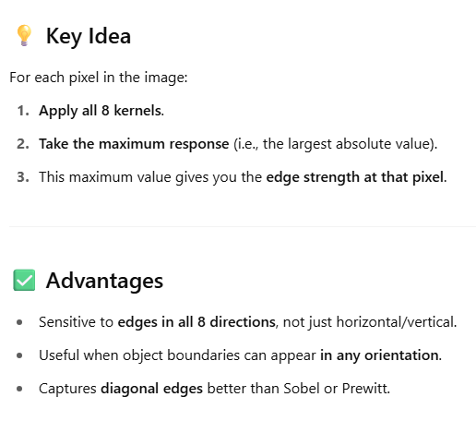
Kirsch Compass Kernels

Slide 21

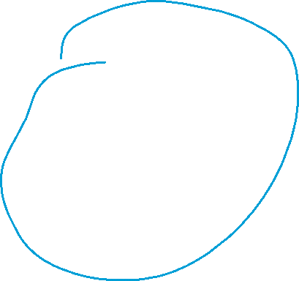
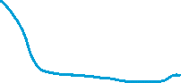



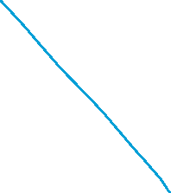

Canny Edge Detection
Image Sharpening - Next Class
A powerful Edge Detection Approach,
Deal with it in the Next Class

Slide 22
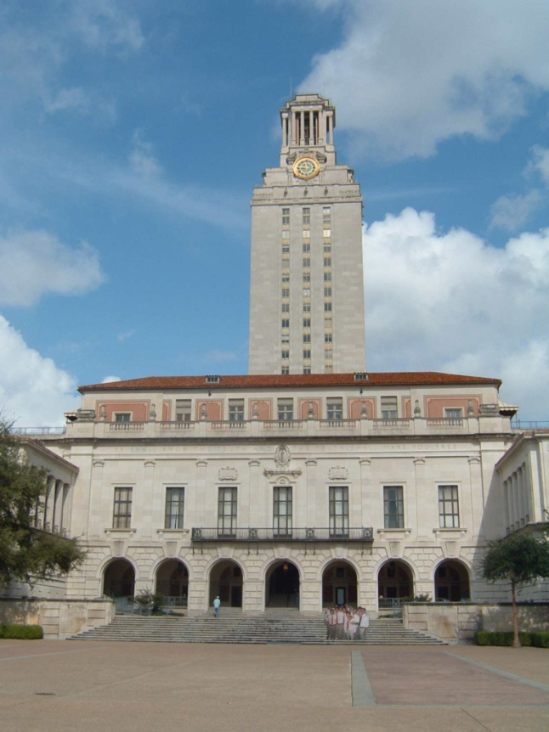
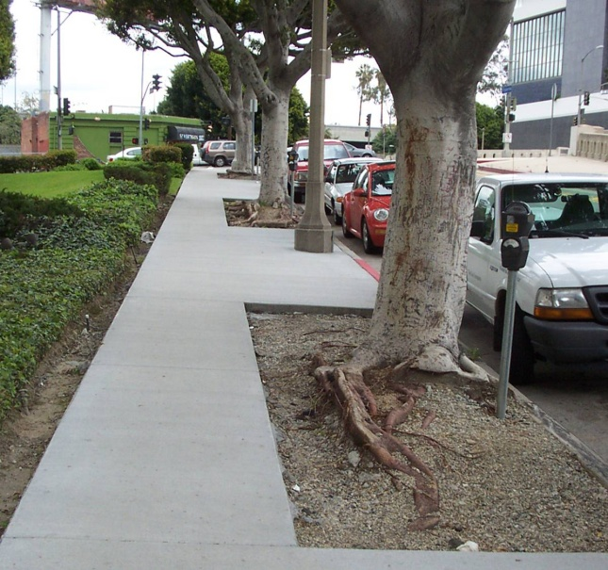
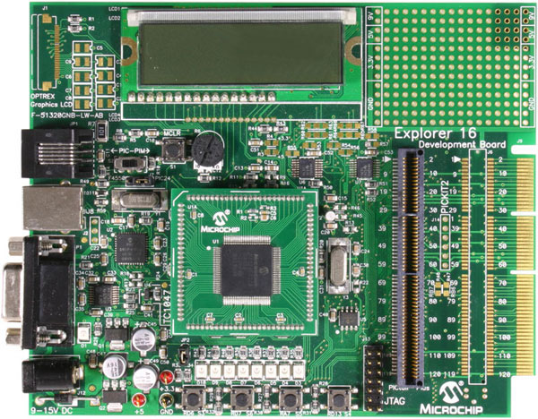
Line Fitting
Many objects characterized by presence of straight lines
Wait, why aren’t we done just by running edge detection?

Slide 23
Why Do We Need It?
Edge detection finds "where something changes," but those changes are often noisy and scattered. Line fitting helps in:
Summarizing scattered points into meaningful straight lines.
Extracting geometric features like lanes, walls, pipes.
Noise reduction: Focus on dominant structure, ignore clutter.
Imagine placing dots on a paper (edge pixels), and then trying to draw a ruler-straight line that best fits those dots — that’s line fitting!

Slide 24
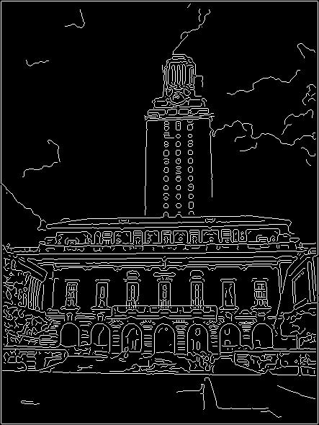
Difficulty in Line Fitting
Extra edge points (clutter), multiple models:
which points go with which line, if any?
Only some parts of each line detected, and some parts are missing:
how to find a line that bridges missing evidence?
Noise in measured edge points, orientations:
how to detect true underlying parameters?
Kristen Grauman

Slide 25
Types of Line Fitting Methods
Method | Description
Least Squares Fitting | Finds a line that minimizes the squared distance from all points to the line.
RANSAC | Robust method that ignores outliers and fits line only through consistent points.
Hough Transform | Powerful method for detecting all lines in an image using voting in parameter space. (More on this soon.)

Slide 26
Intuition Behind Hough Transform for Line Fitting
Problem:
You have an edge-detected image (after applying Sobel or Canny), and now you want to find lines — especially straight lines that may be partially broken or not perfectly continuous.

Slide 27
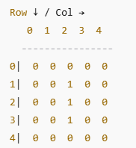
Step 0: Edge Image (Input)
Assume we have this 5×5 binary image (1 = edge pixel):
This clearly shows a vertical line at x = 2.
Edge points:
(x=2, y=1), (2, 2), (2, 3)

Slide 28
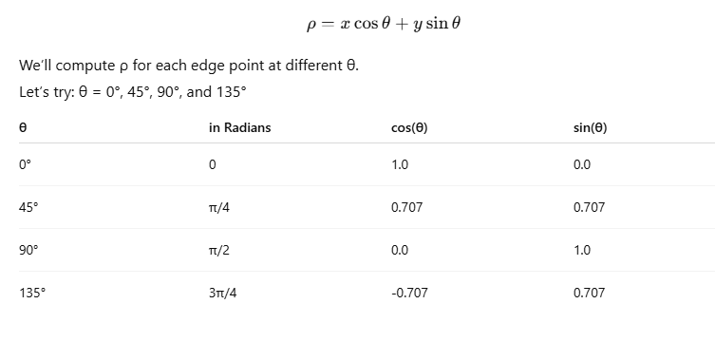
Step 1: Parametrize a Line
θ: angle of the line's normal (0 to 180 degrees)
ρ: perpendicular distance from origin to the line

Slide 29
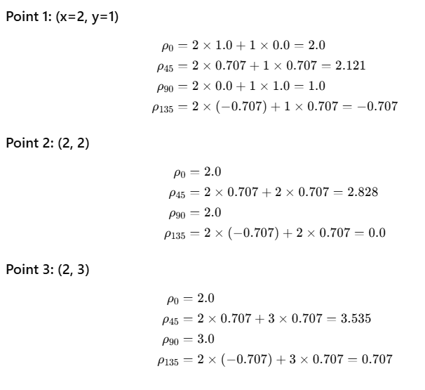
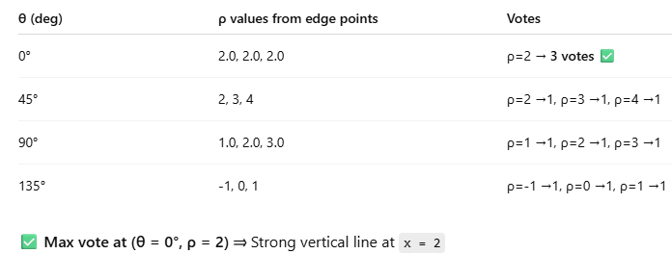


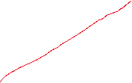

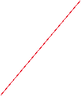
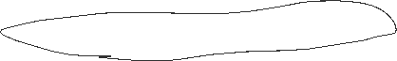
Step 2: Compute ρ for all Edge Points
Step 3: Voting in Accumulator
Each edge point contributes a curve in (θ, ρ) space.
If multiple edge points lie on the same line, their curves will intersect at one point (θ₀, ρ₀). This point gets maximum votes, revealing a line in image space.

Slide 30
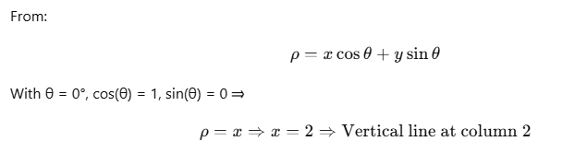

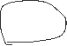

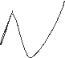
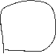
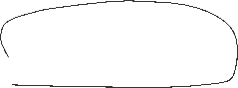
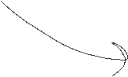
Step 4: Back to Image Space

Slide 31
Role of Voting in Line Fitting
It’s not feasible to check all combinations of features by fitting a model to each possible subset.
Voting is a general technique where we let the features vote for all models that are compatible with it.
Cycle through features, cast votes for model parameters.
Look for model parameters that receive a lot of votes.
Noise & clutter features will cast votes too, but typically their votes should be inconsistent with the majority of “good” features.
Kristen Grauman

Slide 32
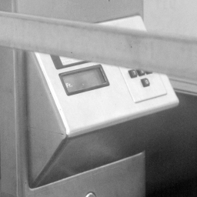


Hough Transform for Line Fitting
Given points that belong to a line, what is the line?
How many lines are there?
Which points belong to which lines?
Hough Transform is a voting technique that can be used to answer all of these questions.
Main idea:
1. Record vote for each possible line on which each edge point lies.
2. Look for lines that get many votes.
Kristen Grauman

Slide 33


Hough Transform for Line Fitting
Equation of a line?
y = mx + b
y
b
b₀
x
m₀
m
image space
Hough (parameter) space
Connection between image (x,y) and Hough (m,b) spaces
A line in the image corresponds to a point in Hough space
To go from image space to Hough space:
given a set of points (x,y), find all (m,b) such that y = mx + b
What does a point (x₀, y₀) in the image space map to?
Answer: the solutions of b = -x₀m + y₀
this is a line in Hough space
Kristen Grauman

Slide 34
Hough Transform for Line Fitting
Equation of a line?
y = mx + b
y
b
y₀
x₀
x
m
image space
Hough (parameter) space
What are the line parameters for the line that contains both (x₀, y₀) and (x₁, y₁)?
It is the intersection of the lines b = –x₀m + y₀ and b = –x₁m + y₁
Kristen Grauman

Slide 35
Hough Transform for Line Fitting
Equation of a line?
y = mx + b
y
b
x
m
image space
Hough (parameter) space
How can we use this to find the most likely parameters (m,b) for the most prominent line in the image space?
Let each edge point in image space vote for a set of possible parameters in Hough space
Accumulate votes in discrete set of bins; parameters with the most votes indicate line in image space.
Kristen Grauman

Slide 36


Hough Transform for Line Fitting
CV 4: Edge and Line Detection
Shree K. Nayar

Slide 37

Hough Transform for Line Fitting
Shree K. Nayar

Slide 38

Hough Transform for Line Fitting
Shree K. Nayar

Slide 39





Polar Representation of Lines
Image columns
[0,0]
: perpendicular distance from line to origin
: angle the perpendicular makes with the x-axis
Image rows
Shree K. Nayar

Slide 40





Alternate formulation using Polar Representation of Lines
ⲣ : perpendicular distance from line to origin
Θ : angle the perpendicular makes with the x-axis
Shree K. Nayar

Slide 41

Alternate formulation using Polar Representation of Lines
Shree K. Nayar

Slide 42




Examples - Hough Transform
Kristen Grauman

Slide 43
Readings:
Hough Transform - Page 737 - 742 - Digital Image Processing, 4th Ed, Rafael C. Gonzalez & Richard E. Woods
Next Class:
Image Sharpening; Linear Filters; Edge Detection using Canny; Line detection using Hough transforms; [ if possible]

Slide 44
Thank you

